Slide 1
Iris Classification
Lab 2

Slide 2
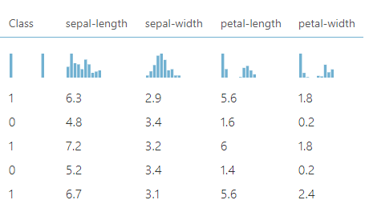
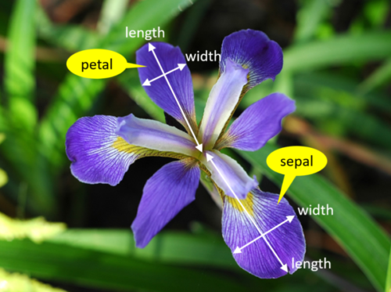
Dataset Details
Data consists of the lengths and widths of the sepal and petal of irises of two species
100 observations and 4 attributes, with Class being the target label.
No missing values.

Slide 3
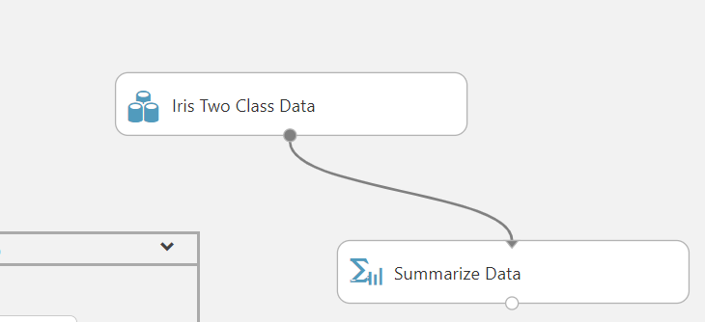

Slide 4
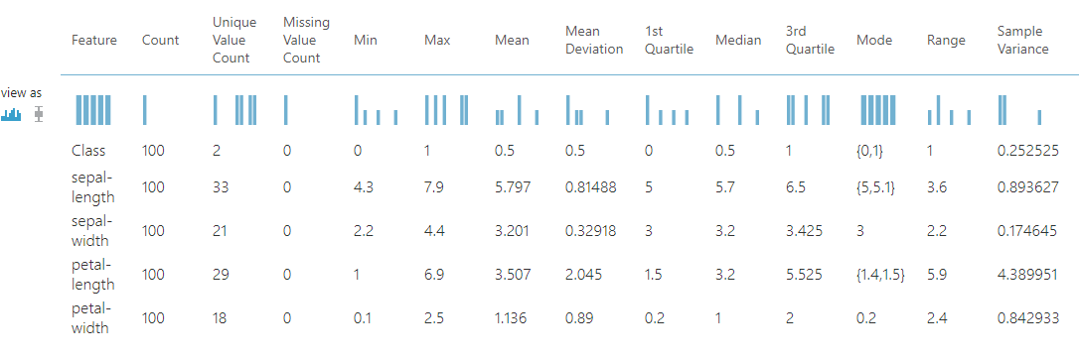
Descriptive Statistics

Slide 5
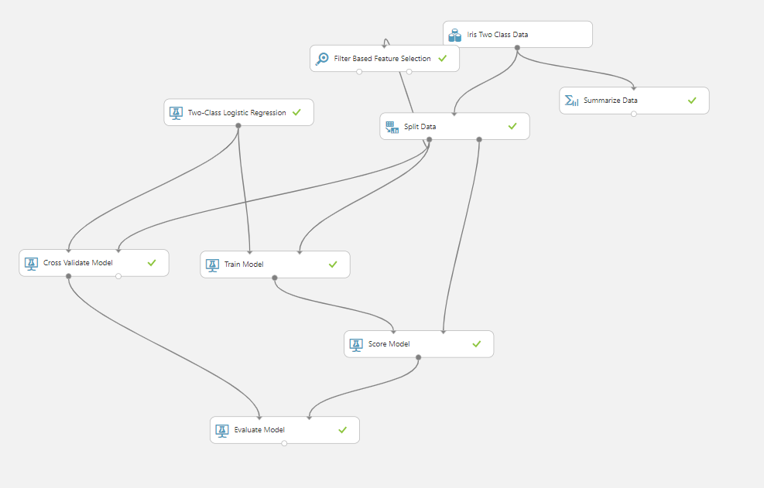
Initial Workflow
The data was split 80:20
10-fold cross validation done on the training set
Results for 10-fold CV were compared with the results on the hold out set

Slide 6
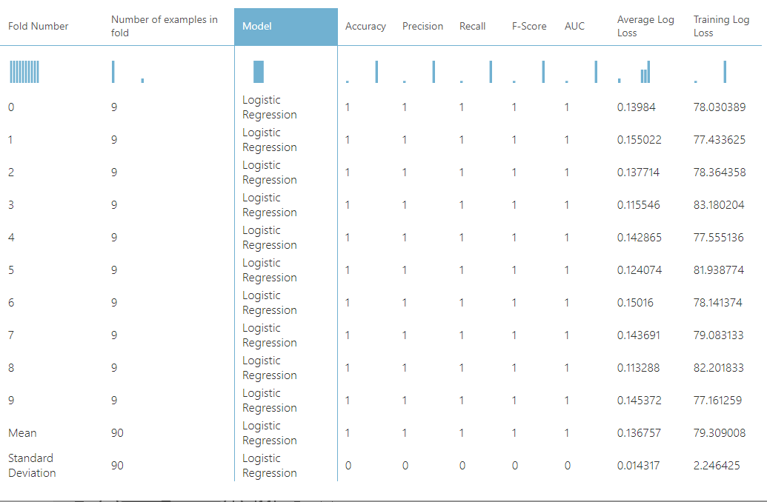
Results of each CV fold

Slide 7
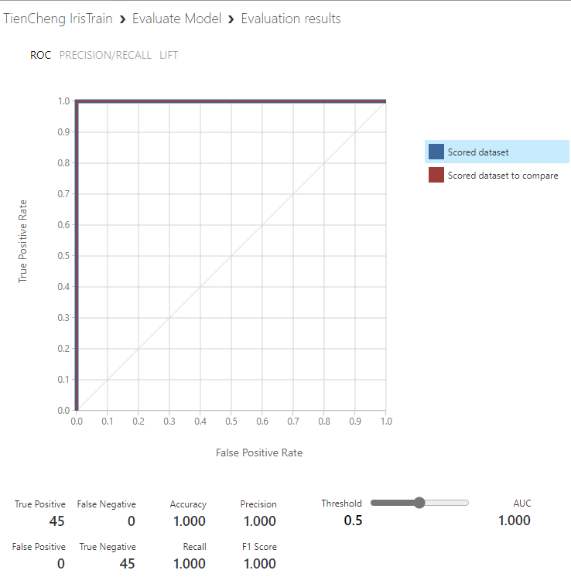
Model: Logistic Regression
Logistic Regression performed well on both cross-validation and the hold-out set, having a perfect accuracy of 100%.

Slide 8
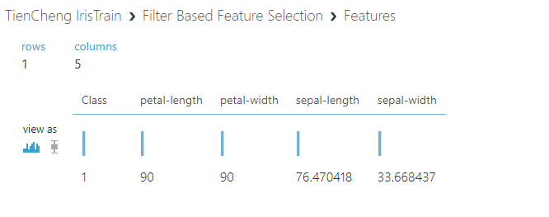
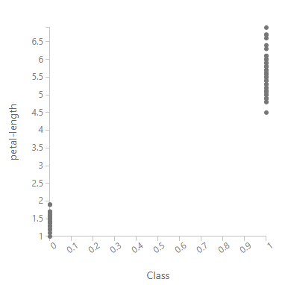
Feature Importances
Based on a Chi Squared test conducted on the features, petal length and width had the greatest association with the class label.

Slide 9
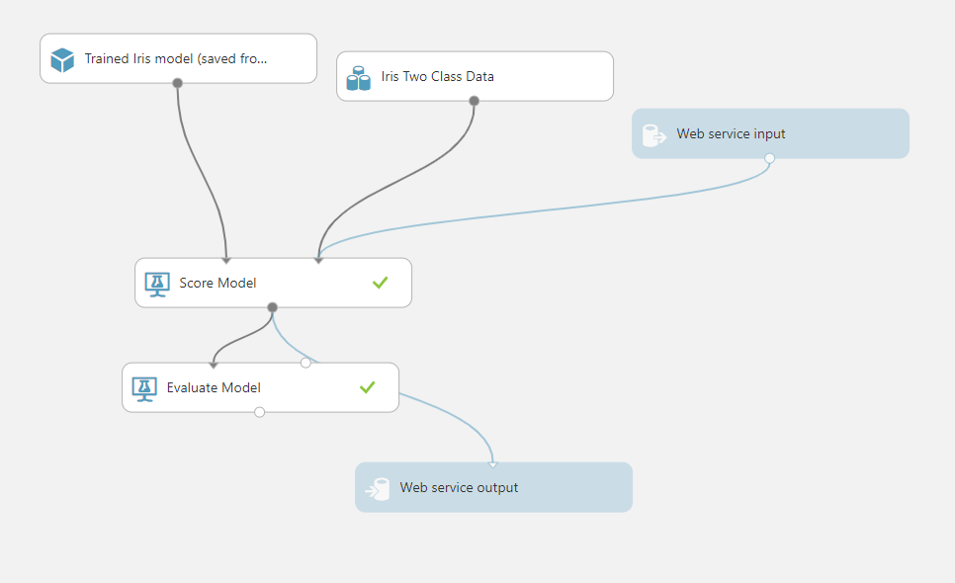
Web Service Deployment

Slide 10
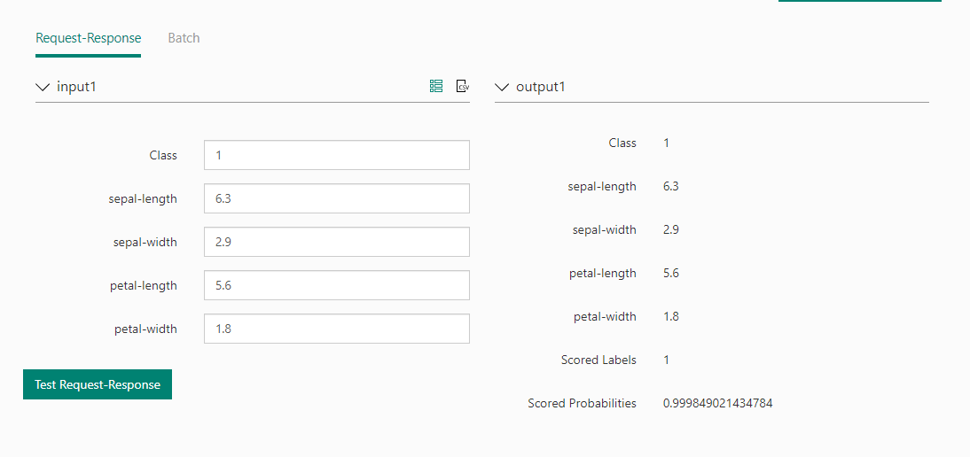
Web Service Deployment

Slide 11
References
ML Studio (classic): Split Data - Azure | Microsoft Docs
ML Studio (classic): Filter Based Feature Selection - Azure | Microsoft Docs
ML Studio (classic): Cross-Validate Model - Azure | Microsoft Docs
Stöwer_Titanic.jpg (640×438) (wikimedia.org)

